Slide 1
Part of my presentation for Exporation Days 2022
Rebecca Rushforth

Slide 2

AWS Lambda Snapstart for Java Corretto 11
Optimisation for lambda startup
Lambdas use Firestarter mini VMs
This takes a snapshot of a started VM and restores that when the lambda is invoked, instead of starting a new one
Should reduce latency
Particularly relevant for Java because of time to start JVM

Slide 3
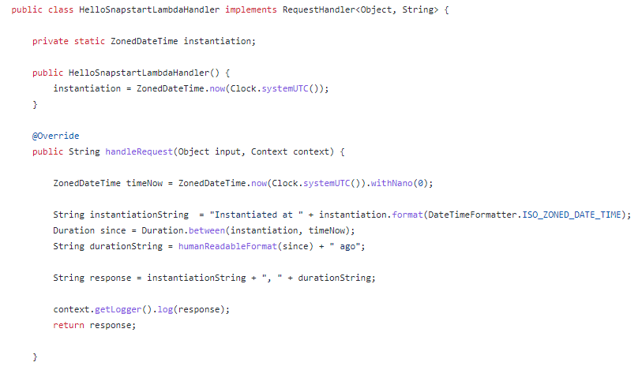


What happens before snapshotting?
https://github.com/mo-rjr/hello-snapstart-lambda

Slide 4

Probably should have known this already…
log line without snap start: “Duration: 94.91 ms Billed Duration: 95 ms Init Duration: 315.19 ms”
If less than 10 seconds, lambda init is free as long as it’s zipped code on a managed runtime
Containers don’t get this
Init also gets two unthrottled vCPUs
This is not official so might change
Notes:
https://bitesizedserverless.com/bite/when-is-the-lambda-init-phase-free-and-when-is-it-billed/

Slide 5
Digression: changing init
at present, limited initialisation in the init phase of the lambda
but lambdas do not reinitialise if they are warm
tried swapping to make them do all the initialisation in the init phase if they are cold
tried it out on SWFHIM…
but it didn’t seem to make a difference to billed duration

Slide 6
Cost vs latency

Slide 7

Teething problems?
First few restorations not in the last graph because they were weirdly slow:
636ms
1660ms
1859ms

Slide 8
Snapstart conclusions
Latency matters for an API where a human is waiting for data, but most of our APIs are codeless
I tried a warnings-manager-ws but stymied by S3…
Only in Ireland so far
Requires lambdas to be published – easy but not what we usually do
Needs careful thought about what happens in the init phase – init once per several weeks rather than once per 6/7 minutes as now…
AWS have made a tool AWS Lambda SnapStart Bug Scanner to find troublesome state
“no additional charge”!
aimed at big frameworks – Quarkus and micronaut already have support
I want to incorporate this into my examination of native compilation lambdas. Is it better than compiling to native because you can still use Hotspot JVM? SWFHIM code is the place to do this…

